Slide 1
Panasonic data breach
Syed mujahid hamid ali

Slide 2


AGENDA
INTRODUCTION
Organization background
Breach timeline
Technical details
Actions taken by organization after the incident

Slide 3

INTRO
In February 2022, Panasonic's operations experienced a cyberattack orchestrated by the Conti Ransomware-as-a-Service (RaaS) group. The attack targeted internal systems, processes, and networks, prompting an immediate response from Panasonic. The company collaborated with cybersecurity experts and service providers to assess the impact, contain the malware, clean and restore servers, rebuild applications, and communicate swiftly with affected customers and relevant authorities. Conti claimed to have stolen around 3 GB of data, including internal files from Panasonic's HR and accounting departments. Notably, this cyberattack followed a similar incident in November 2021, underscoring the escalating challenges and frequency of ransomware attacks across diverse industries globally.

Slide 4

Organization background
Panasonic is a Japanese multinational electronics corporation that produces a wide range of products, including home appliances, audio equipment, and cameras.

Slide 5
Breach TIMELINE
NOV 2021 | Panasonic gets attacked and some vulnerabilities could have been found that were exploited in this attack
FEB 2022 | Panasonic was hit with an attack that affected various internal systems, processes and networks
APR 2022 | Panasonic confirmed the attack and outlined the immediate actions to be taken
POST- INCIDENT | Panasonic worked to understand the impact and focused on restoring operations by mitigating the impact

Slide 6
TECHNICAL DETAILS
NATURE OF THE ATTACK:
Was a targeted ransomware attack.
RESPONSIBILITY CLAIM:
Claimed by Conti RaaS group.
ALLEGATIONS:
Data exfiltrated was more than 2.8 GB.
Included internal files, documents and spreadsheets.
Mainly stolen from the accounting and HR departments.
BREACH METHOD:
Not mentioned specifically in official reports but was most likely a phishing attack paired along with stolen credentials to gain access.
CONTAINMENT AND RESPONSE:
Took immediate action by identifying the impact scope, containing the malware, restoring servers, etc.
COMMUNICATION:
Communicated with affected parties and relevant authorities.

Slide 7
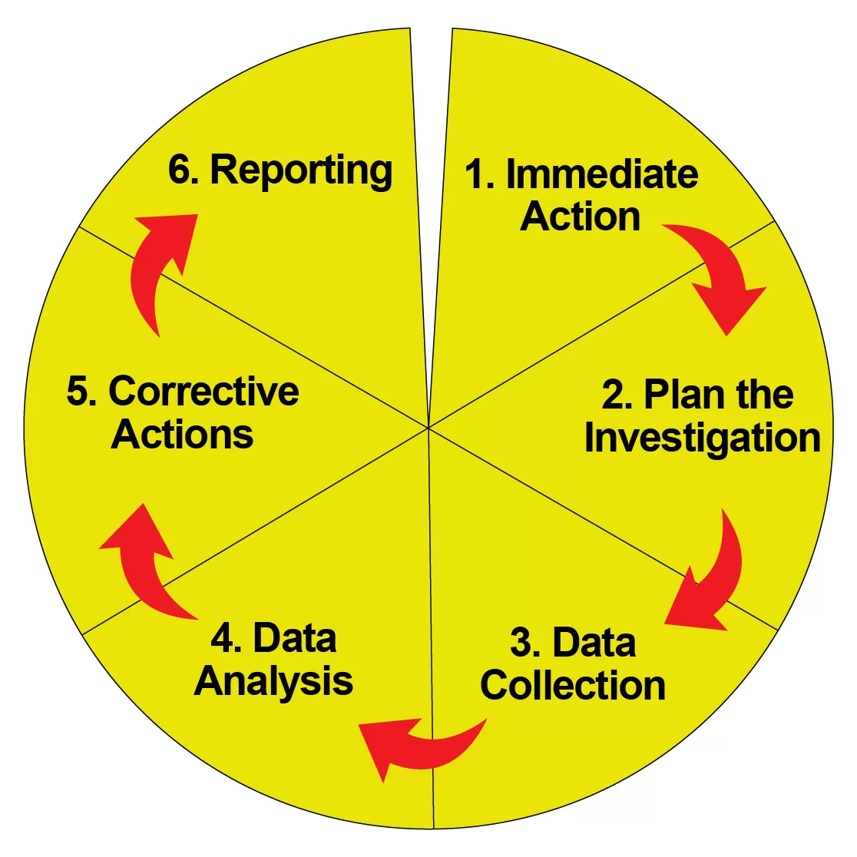
Actions taken by the organization after the incident
IMMEDIATE INCIDENT RESPONSE:
Isolation of affected systems
Assessing extent of breach
Determining what data and systems were affected
EXPERT ENGAGEMENT:
Enlisted the help of experts and service providers
Responsible for conducting a detailed analysis to understand everything about the incident
MALWARE CONTAINMENT:
Disconnecting the infected machines from the network and taking down the compromised servers
SERVICE RESTORATION:
Removed any trace of the malware and restored from backup to resume normal operations

Slide 8
Actions taken by the organization after the incident
APPLICATIONNS REBUILDING:
Restored the applications that were infected to ensure they were free of any vulnerabilities
COMMUNICATION:
Affected parties were given the information about the incident as soon as it could have been told
IMPACT INVESTIGATION:
Worked to understand the full impact of the attack on customers and employees
Assessed the nature of the leaked data and consequences of the data exposure
MITIGATION EFFORTS:
Focused on mitigating any impact from the incident
Strengthened the cybersecurity posture to prevent and protect themselves from any future similar incidents

Slide 9

SUMMARY
A targeted ransomware attack executed by the Conti ransomware-as-a-service group in February 2022 was examined. This cyberattack compromised over 2.8 GB of sensitive data, predominantly from the HR and accounting departments. Panasonic's immediate response involved a swift containment of the malware, followed by extensive cleaning and restoration of affected servers and applications. The company prioritized transparent communication with impacted customers and authorities, while engaging cybersecurity experts for a thorough forensic analysis. The incident underscores the critical need for robust cybersecurity measures and preparedness for rapid response to such threats. It highlights the ongoing challenges faced by global corporations in safeguarding sensitive data against increasingly sophisticated cyber threats.

Slide 10
THANK YOU
Syed Mujahid Hamid Ali

